Slide 1


CREDIT CARD FRAUD PREDICTION
Soma Shekar Vayuvegula
Notes:
Hello Everyone, Today we are going to discuss about Credit Card Fraud Detection System. Hope this session will be interesting and engaging

Slide 2
INTRODUCTION
As the world progresses toward digitization, we rely on digital payments. While digital payments are on the rise, frauds in digital payments especially using a credit card, are increasing, and cybersecurity has become a crucial part of the credit card industry.
Credit Card Fraud Prediction System will bear considerable benefits to the customers and credit card firms so that we can reduce financial risks and losses due to these frauds.
As the system develops to predict fraudulent activities on credit card transactions, fraudsters will create new ways of doing things. So, we can not rely on standard rules for identifying fraudulent patterns.
We need to develop a system that gets trained with new patterns and identifies fraudulent activities as recent frauds develop.

Slide 3
PROJECT STEPS
Data Collection
Data Cleansing & Transformation
Build and Train Model
Exploratory Data Analysis
Model Evaluation
Notes:
First step is Data Collection - As part of this step, we have collected required data from Kaggle
Next step is Data Cleansing and Transformation - As part of this step, we have cleansed and transformed data as per the project requirements.
Next step is Exploratory Data Analysis - As part of this step, we have various visualizations which will explain the data sourced for this project.
Next step is Build and train model - As part of this step, we have built and trained various models.
Last step is Model Evaluation - As part of this step, we have evaluated all the models and compared the accuracy score.

Slide 4
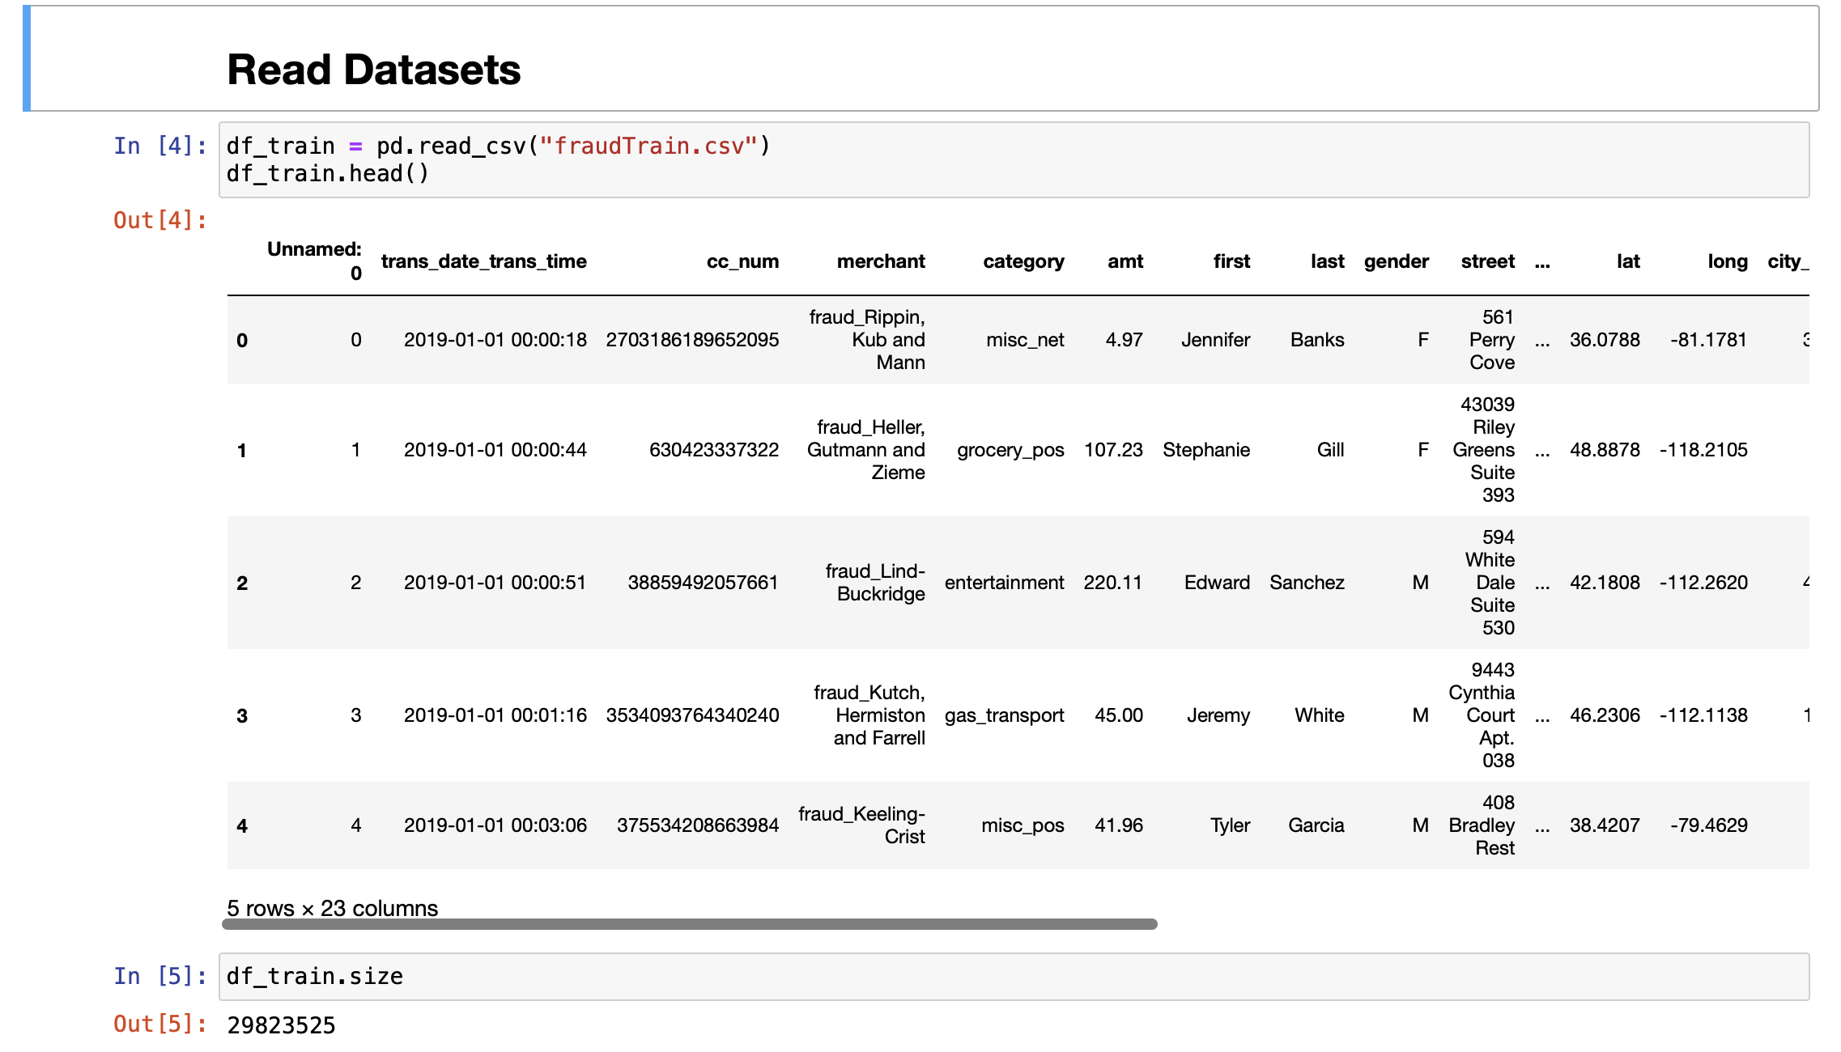
DATA PREPARATION
Notes:
The next two slides are about Data preparation, As part of this step, we have used two datasets one is training dataset and the other is test dataset. However, we have combined these datasets before building the models as these datasets are imbalanced, we have applied sampling to balance the datasets and then split into training and test datasets.

Slide 5
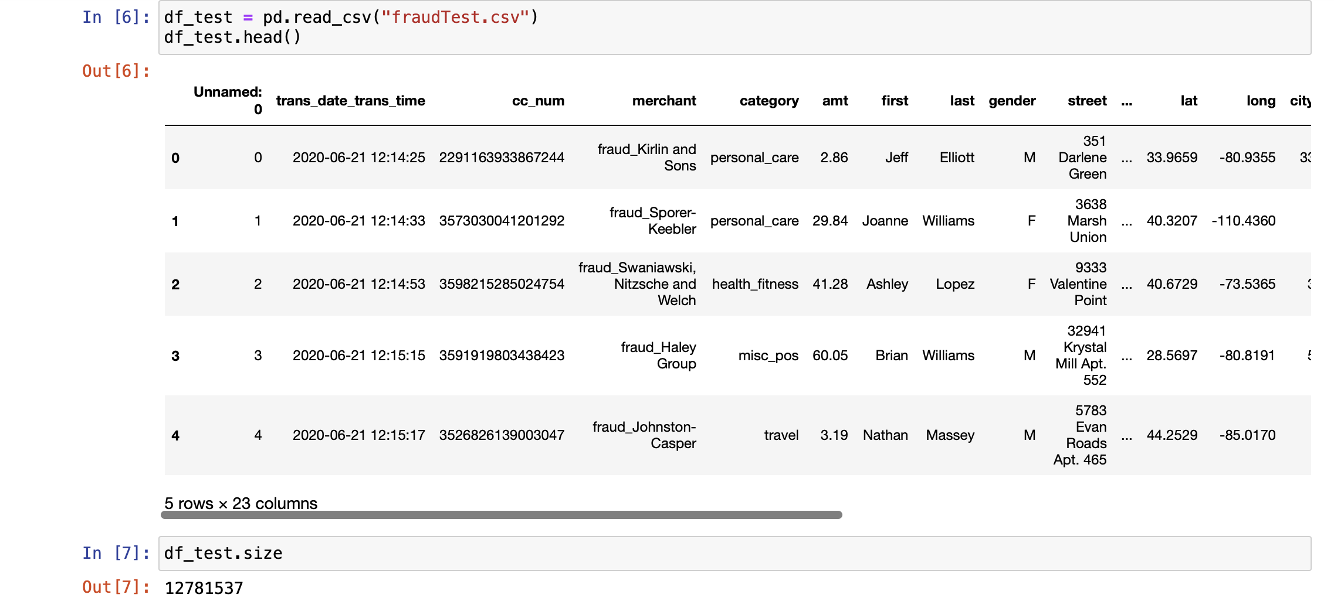
DATA PREPARATION

Slide 6
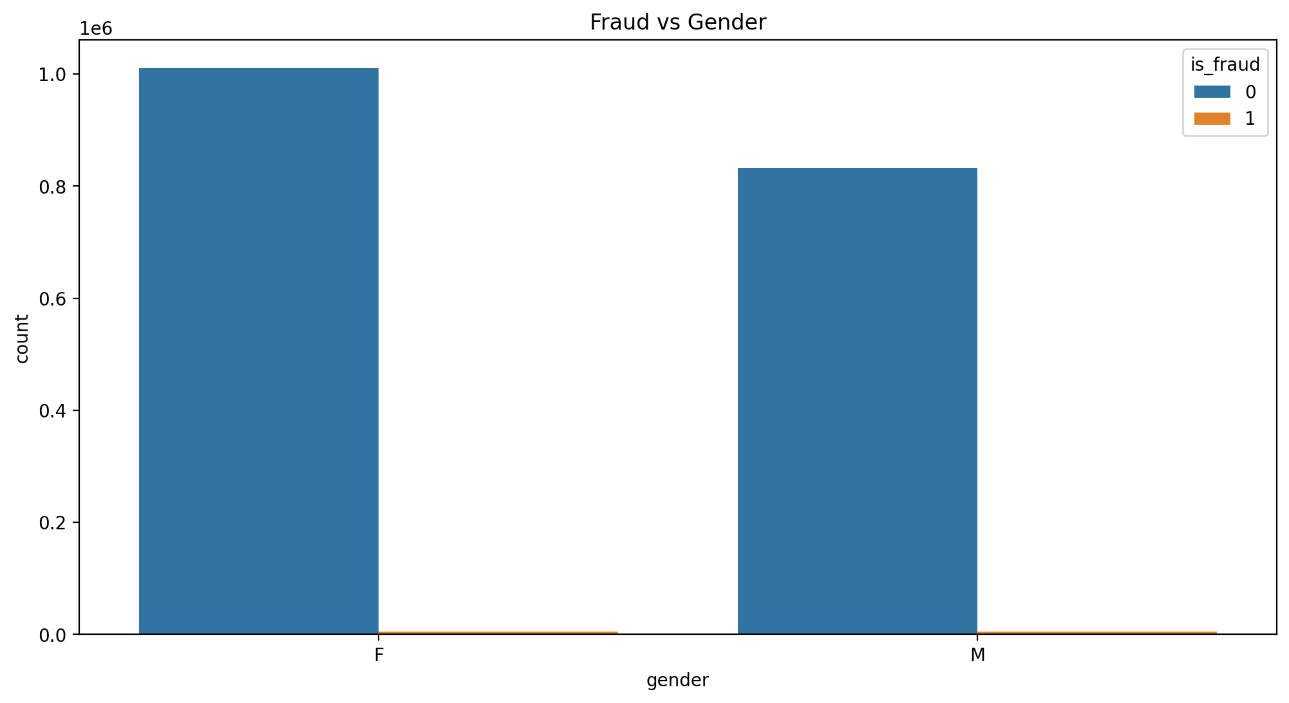
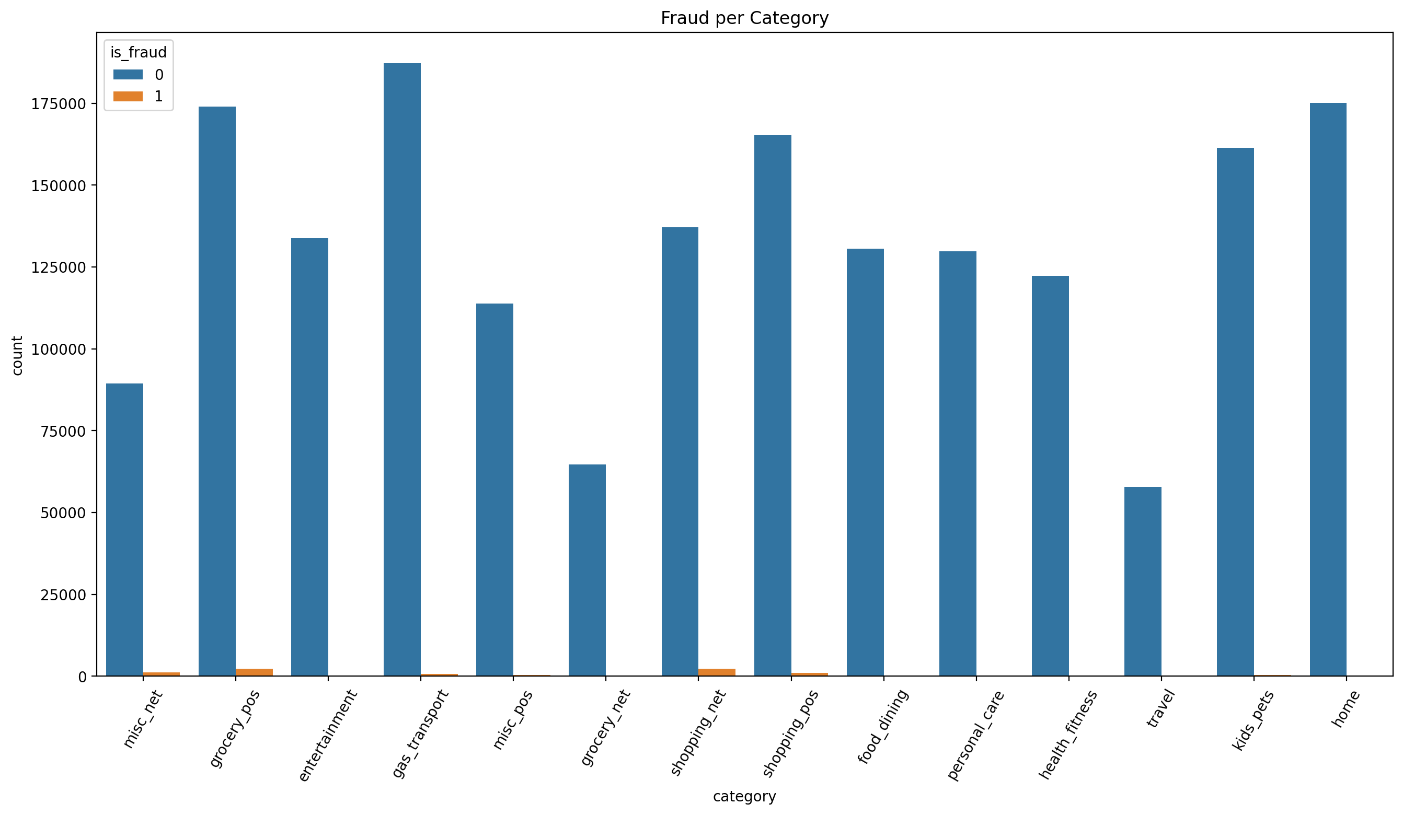
EXPLORATORY DATA ANALYSIS
Notes:
This slide is about Exploratory Data Analysis - here we have plotted two graphs. The first one is Fraud vs Gender. As per this graph, Men were involved in more frauds than women.
The second graph is about fraud per category, upon analyzing the graph, we see that gas and transportation has more fraud and travel has the least

Slide 7
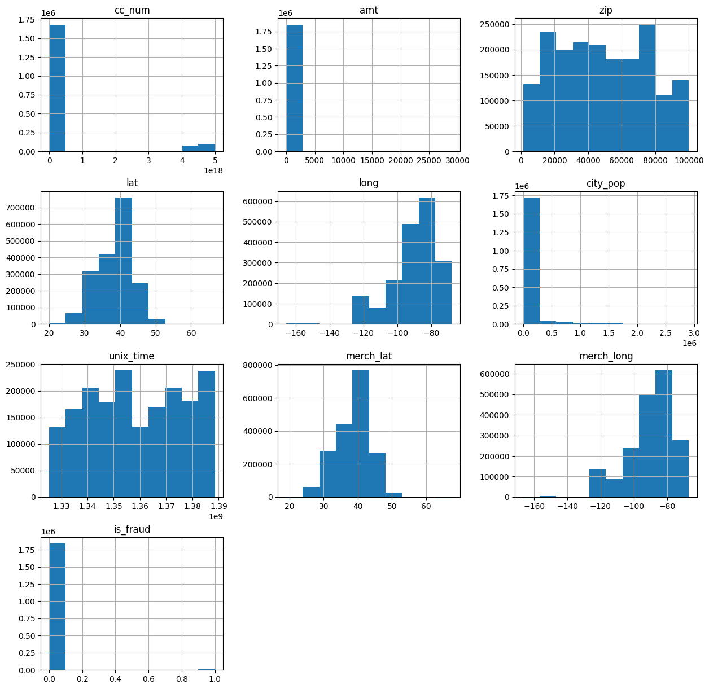
EXPLORATORY DATA ANALYSIS
Notes:
This slide is also about eda, this graph shows how all the columns are distributed

Slide 8
LOGISTIC REGRESSION MODEL
Logistic Regression model estimates probabilities that for instance belong to a particular class.
Logistic Regression helps us to predict if the transaction is a fraud.

Slide 9
RANDOM FOREST MODEL
Random Forest model is a Supervised Learning algorithm. This is widely used for Classification and Regression problems. It builds multiple decision trees and takes a majority vote to classify.
Random Forest algorithm is used to classify fraud transactions in real-time or batch processes.

Slide 10
DECISION TREE MODEL
Decision Tree model is a Supervised Learning used to make predictions based on how the previous set of questions is answered.
Constructing a proper decision tree can be helpful in credit card fraud prediction. We can see if the transaction is fraudulent or not.

Slide 11
XG BOOST ALGORITHM
XGBoost is a decision-tree-based ensemble Machine Learning algorithm. It uses a gradient-boosting framework.
This is a popular and open-sourced gradient-boosted tree algorithm. As this algorithm has gained popularity over time, I have implemented it in this project to see if it performs better than the other algorithms listed above.

Slide 12
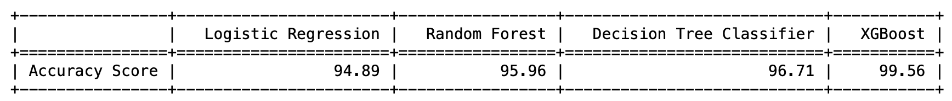
MODELS COMPARISON

Slide 13
ETHICAL IMPLICATIONS
Though this project's credit card transaction data is simulated, it can match real-time PII data.
Credit card fraud detection might not work as expected with smaller datasets. As we are using a smaller dataset, I am not confident that the model accuracy is as expected.

Slide 14
CONCLUSION
After evaluating the models, we observed that the XGBoost model has an approximate accuracy of 99.56%
To make this application easily accessible to Bankers and Credit Card industry, we can implement an API to provide if the transaction is fraud.

Slide 15
REFERENCES
SHENOY, K. (n.d.). Credit Card Transactions Fraud Detection Dataset. Kaggle. https://www.kaggle.com/datasets/kartik2112/fraud-detection?select=fraudTrain.csv
XIANG, N. (n.d.). Credit Card Fraud Analysis and Modeling. Kaggle. https://www.kaggle.com/code/nathanxiang/credit-card-fraud-analysis-and-modeling

Slide 16
THANK YOU
Notes:
Thanks everyone for joining me in this session today. I am more than happy to answer any questions. Please feel free to reach out to me.

